Slide 1
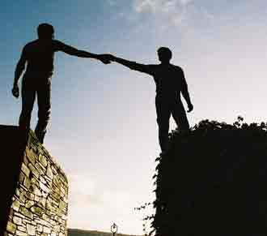
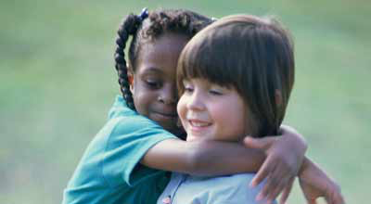
Yowm Kippurym: Day of Reconciliations
To continue,
click your mouse or
press the spacebar.
By Molly Sherman

Slide 2
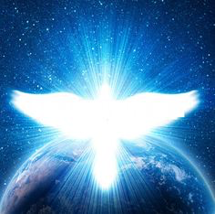
Yowm Kippurym (Day of Reconciliations) in Towrah 6th step in our walk to Yah
After teaching about Taruw’ah, Yahowah said to Moseh:
"On the tenth of the seventh month is the Day (Yowm) of Reconciliations (Kippurym). This exists as a set-apart and cleansing Called Out Invitation (miqra’ – a special meeting for reading and reflecting) for you. And your soul (nepesh) is to respond, (‘anah – answer) approaching and appearing before the Adoptive Mother who purifies, enlightens, and elevates unto Yahowah.
Qara’ / Called Out / Leviticus 23:26-27
7 is number of shabat promise - Man (6) + God (1) = 7 (perfection!)
Yah’s Set-Apart Spirit - She provides us access to Yah when we answer His call.
Kippurym is based upon kaphar “cover over” as the Set-Apart Spirit covers us with the Garment of Light (just as Noach’s ark was covered and protected in pitch).
Yownah – Yah’s Dove
Set-Apart Spirit Symbol

Slide 3
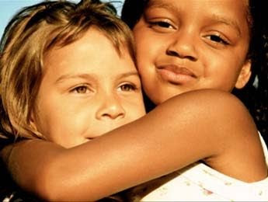
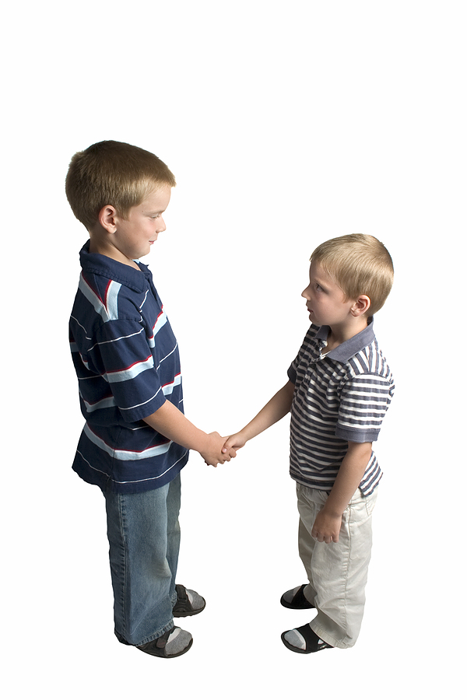
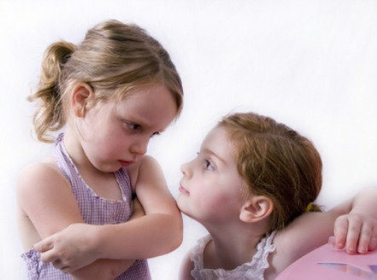
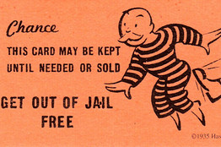
Yowm Kippurym (Day of Reconciliations) in Towrah 6th step in our walk to Yah
Yahowah continues… “Do not perform any of the service of the heavenly messenger on this life-sustaining and empowering day, because this is the Day of Reconciliations for you to be kaphar (to restore a relationship by providing mercy on an unearned and undeserved fortuitous basis, and thereby covering our sin) in the presence of Yahowah, your God.
Qara’/Called Out/Leviticus 23:28
There is nothing that we need to do; the price for our salvation has already been paid by Yah.
To reconcile is to resolve a dispute and restore a relationship.

Slide 4
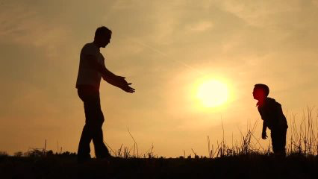
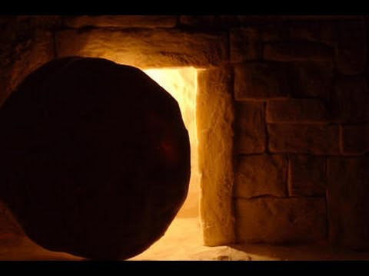
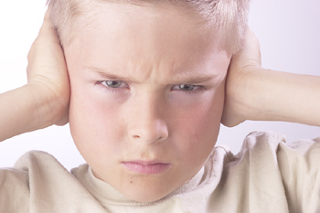
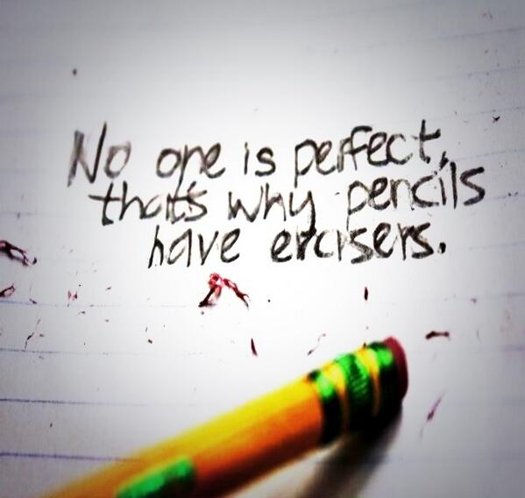
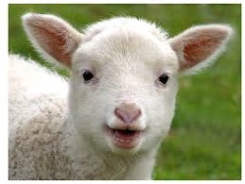
Why do we need to be reconciled?
On Yowm Kippurym, we celebrate our transformation from flawed, mortal souls to immortal, perfect, children of Yah who are empowered/enriched/enlightened
spiritual souls that trumpet Yah’s Torah teaching. Our relationship with Yah has been reconciled and we are welcomed into His family.
Yahowsha’s sacrifices at Passover (Pesach) and Unyeasted Bread (Matsah) enable us to be immortal and perfected, in spite of our faults and weaknesses.
PESACH
Passover
We are adopted into Yah’s family on First Fruits (Bikkurym) and we are enriched and empowered by Yah’s Set-Apart Spirit on Sevens (Shabuwa’), clothed with Her Garment of Light.
MATSAH
Unyeasted Bread
BIKURYM
First Fruits
KIPPURYM
Reconciliations
Yah knows that even though we have a Neshamah (conscience), we still make mistakes and don’t always make the right choices
SHABUWA’
Sevens
TARUW’AH
Trumpets

Slide 5
Yowm Kippurym 2016: Remember, Set Apart and Celebrate
REMEMBER
Remember how we are redeemed through Yahowsha’s sacrifices on Pesach and Matsah
Celebrate the future fulfillment of Yowm Kippurym as we are prepared members of Yah’s Covenant Family
Set apart this day and choose to be with our Heavenly Mother. in the
SET APART
CELEBRATE
“Yahowah’s (Yahowah’s - hwhy- יהוה) Towrah (Towrah – written instruction and teaching, source of direction and guidance) is complete and entirely perfect (tamym – without defect, lacking nothing, correct, sound, genuine, right, helpful, healing, beneficial, and true), returning, restoring, and transforming (suwb – turning around, bringing back, changing, and renewing) the soul (nepesh – consciousness). Yahowah’s (hwhy- יהוה) testimony (‘eduwth – witness) is trustworthy and reliable (‘aman – verifiable, confirming, supportive, and establishing) making understanding and obtaining wisdom (hakam – educating and enlightening to the point of comprehension) simple for the open-minded (pethy).” (Mizmowr / Song / Psalm 19:7)

Slide 6
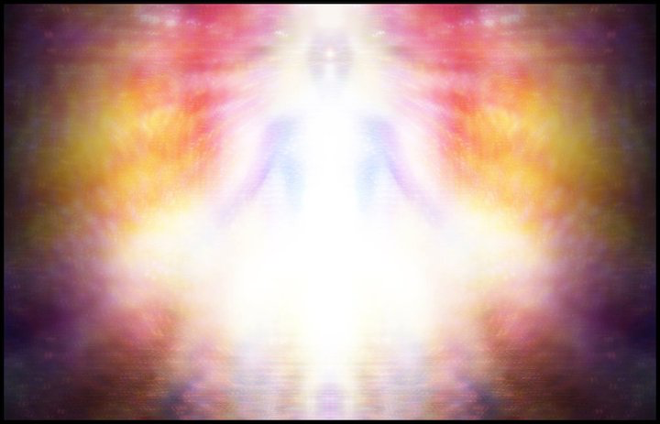
Yowm Kippurym in the future (yet to be fulfilled)
Unlike the first six arrivals, when Yahowah diminished Himself in the form of a man (Yahowsha’), on Yowm Kippurym He will be returning as our God in the form of Light. Yah’s children will be protected by His Spirit and be witnesses as He reconciles His relationship with Yahuwdah and Yisra’el.
“And I will say, ‘You are My people.’ And they will say, “Yahowah is our God.”
Zacharyah / Remember Yah / Zechariah 13:9

Slide 7
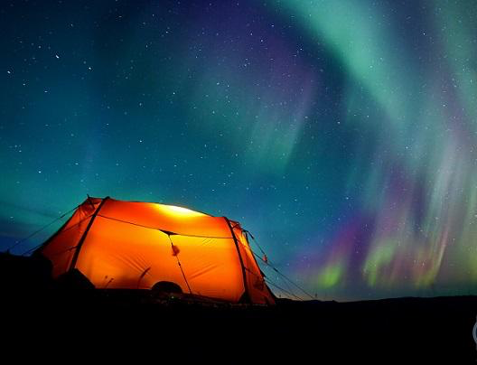
Sukah: Shelters
COMING SOON…

